Slide 1
Sorting techniques Continue

Slide 2
Radix sort
Bucket Sort

Slide 3
Radix Sort

Slide 4
Radix Sort
The lower bound for Comparison based sorting algorithm (Merge Sort, Heap Sort, Quick-Sort .. etc) is Ω(nLogn), i.e., they cannot do better than nLogn.
Counting sort is a linear time sorting algorithm that sort in O(n+k) time when elements are in range from 1 to k.
Radix sort is used to sort numbers using 10 buckets for decimal numbers ranging 0 - 9.
The given numbers are first sorted according to the unit digit and this sorting process continues to the last digit (i.e. the most significant bit) in d-passes for d-digit numbers.
This sorting process continues to the last digit (i.e. the most significant bit) in d-passes for d-digit numbers.

Slide 5
Radix Sort
For a 5- digit numbers, radix sort places numbers in the bucket in 5 passes and combines the buckets five times.
Radix sort is sometimes used to sort records of information that are keyed by multiple fields (i.e. to sort dates by year, month and day).

Slide 6

Radix Sort Algorithm
Take the least significant digit of each key
Sort the list of elements based on that digit, but keep the order of elements with the same digit.
Repeat the sort with each more significant bit

Slide 7
Radix sort
Step 1 - Define 10 queues each representing a bucket for each digit from 0 to 9.
Step 2 - Consider the least significant digit of each number in the list which is to be sorted.
Step 3 - Insert each number into their respective queue based on the least significant digit.
Step 4 - Group all the numbers from queue 0 to queue 9 in the order they have inserted into their respective queues.
Step 5 - Repeat from step 3 based on the next least significant digit.
Step 6 - Repeat from step 2 until all the numbers are grouped based on the most significant digit.

Slide 8
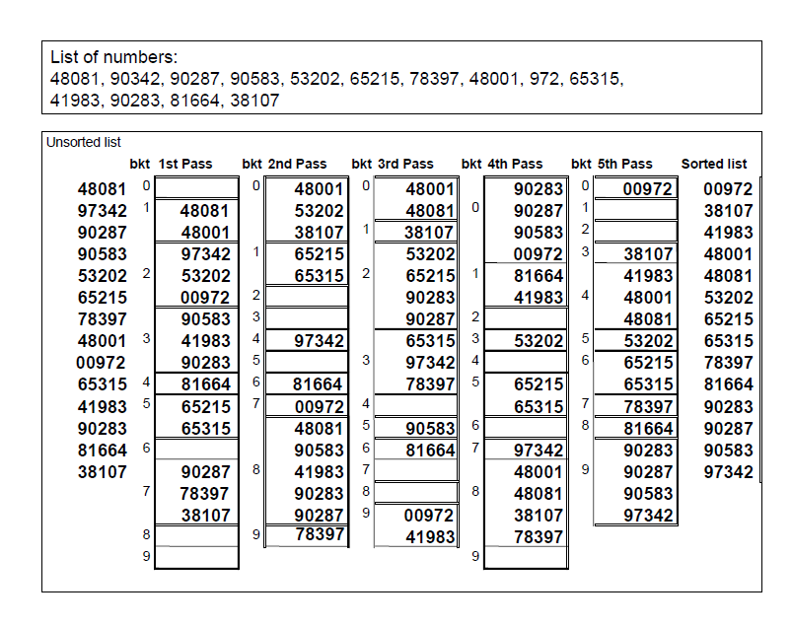
Numerical

Slide 9
Analysis
Number of Iterations = s*(d+n)
Where
d = Digits in a number (d=10 for decimal digit)
s = Number of digits in a number (s = 4 for 972, 8345 & 89 numbers)
n = Number of items (given numbers to be sorted)
Time depends upon comparisons, so time complexity is
O(n)

Slide 10
Analysis
How long does radix sort take?
There are now three parameters
n: the size of the array,
k: the base (in case of decimal number its 10),
now d, the number of digits.
Since counting sort takes O(k + n), which is O(n) for small k, and we do d counting sorts, radix sort takes O(n d) =O(n)

Slide 11
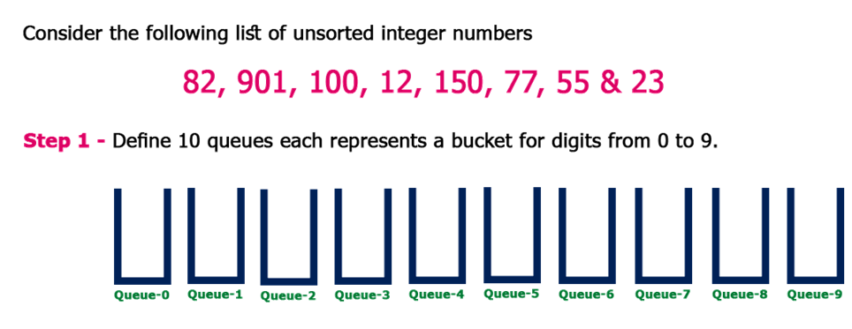

Slide 12
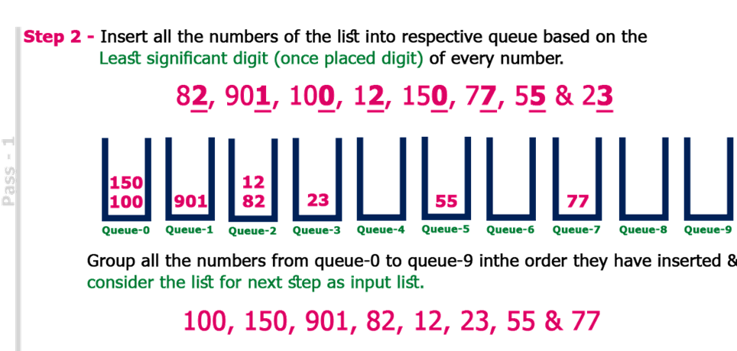

Slide 13
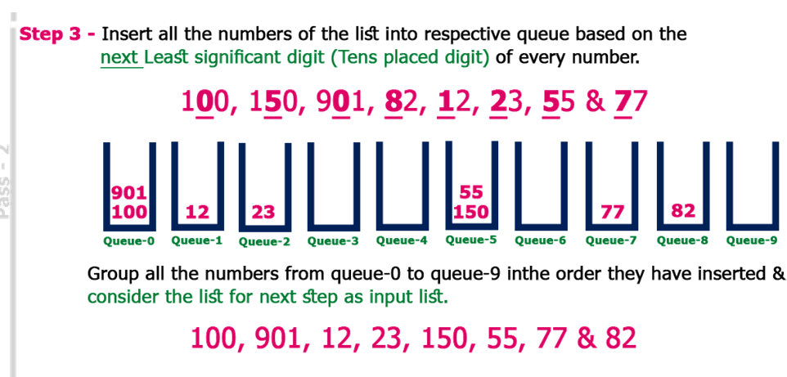

Slide 14
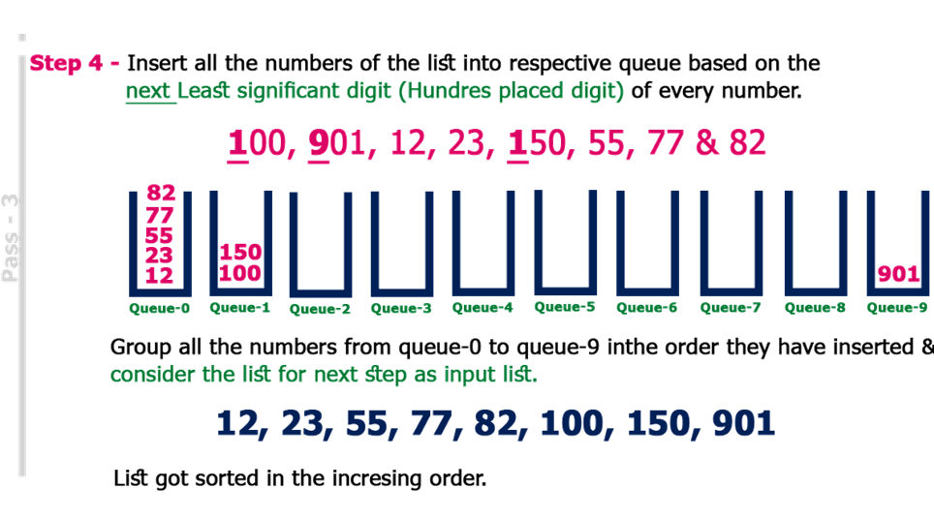

Slide 15
Task
COW,DOG,SEA,RUG,ROW,MOB,BOX,TAB,BAR,EAR,TAR,DIG,BIG, TEA,NOW,FOX

Slide 16
Solution
Keys | Pass 1 | Pass 2 | Pass 3
COW | SEA | TAB | BAR
DOG | TEA | BAR | BIG
SEA | MOB | EAR | BOX
RUG | TAB | TAR | COW
ROW | DOG | SEA | DIG
MOB | RUG | TEA | DOG
BOX | DIG | DIG | EAR
TAB | BIG | BIG | FOX
BAR | BAR | MOB | MOB
EAR | EAR | DOG | NOW
TAR | TAR | COW | ROW
DIG | COW | ROW | RUG
BIG | ROW | NOW | SEA
TEA | NOW | BOX | TAB
NOW | BOX | FOX | TAR
FOX | FOX | RUG | TEA

Slide 17
Task
DOC, SLEEPY, COW, HAPPY, JOY, CARD, SNOW, COLD

Slide 18
Bucket Sort

Slide 19
Bucket Sort
Bucket sort is another algorithm that expects something about the input just like count sort.
Bucket sort assumes that the input is generated by a random process that distributes elements uniformly and independently over the interval [0, 1).
Bucket sorts work well for data sets where the possible key values are known and relatively small and there are on average just a few elements per bucket.
It is mostly used to sort continuous numbers distributed uniformly.

Slide 20
Bucket sort
Bucket sort is a sorting technique in which array is partitioned into the buckets.
By this, each bucket will be sorted individually, by using some another stable sorting algorithm such as insertion sort.
This sorting technique assumes that the input is drawn from a uniform distribution by which it has an average case of O(n).
Since the inputs are uniformly and independently distributed over [0,1), we do not expect many numbers to fall into each bucket.

Slide 21
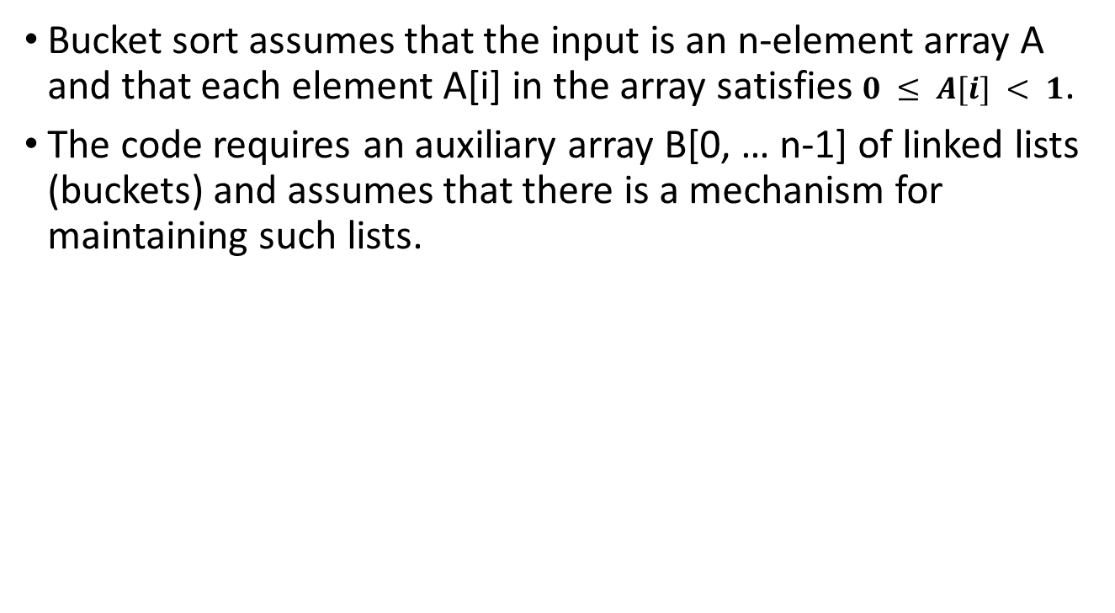
Bucket sort

Slide 22
Bucket-Sort (A)
n = length [A]
2
for i = 1 to n
3
do insert A [i] into list B [n * A [i]]
4
for i = 0 to n - 1
5
do sort list B [i] with insertion sort
6 concatenate the lists B[0], B[1] ... B[n-1] together in order

Slide 23
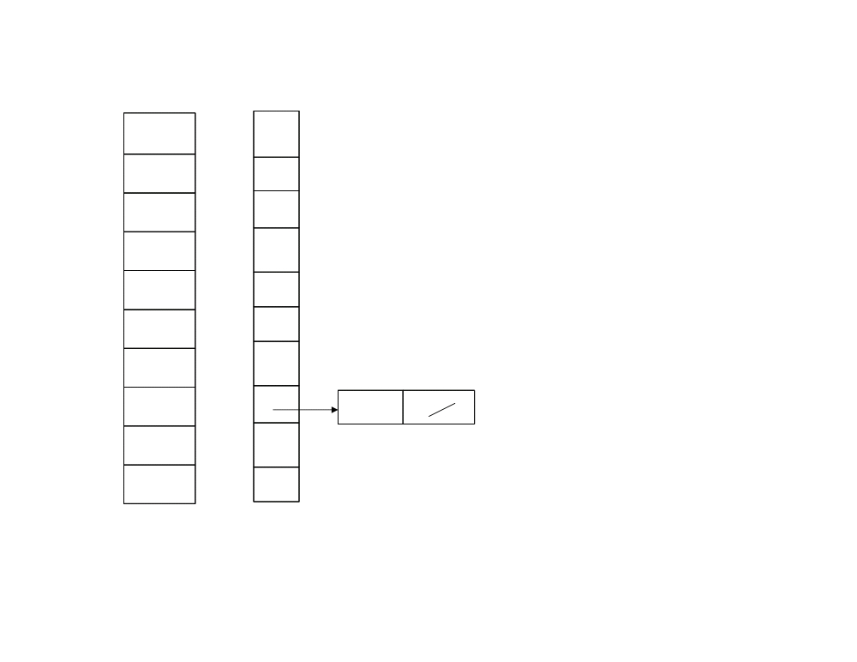
A
B
1 n = 10
2 for i = 1
1
.78
0
3 do insert A[1] into list B[10 * A [1]]
2
.17
1
3
.39
2
4
.26
3
5
.72
4
6
.94
5
7
.21
6
8
.12
7
.78
9
.23
8
10
.68
9

Slide 24
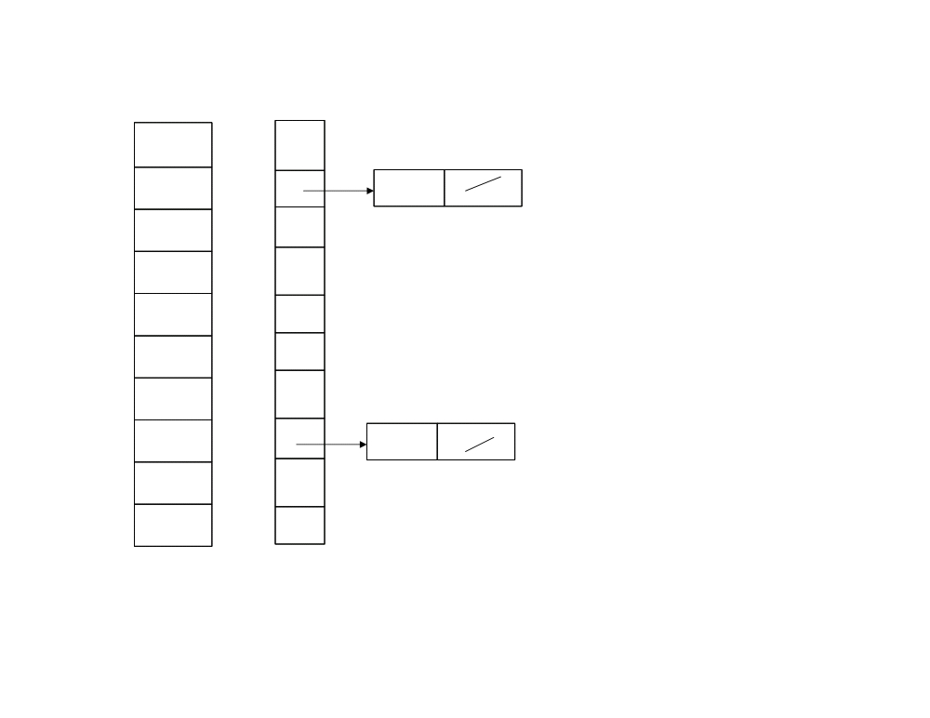
A
B
1 n = 10
2 for i = 2
1
.78
0
3 do insert A[2] into list B[10 * A [2]]
2
.17
1
.17
3
.39
2
4
.26
3
5
.72
4
6
.94
5
7
.21
6
8
.12
7
.78
9
.23
8
10
.68
9

Slide 25
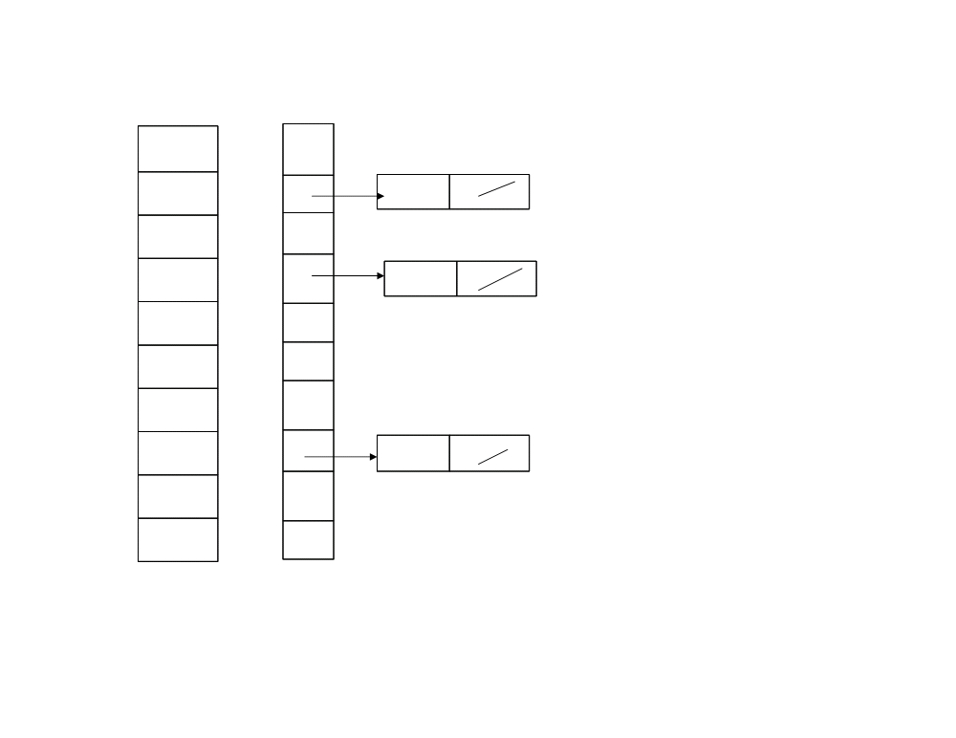
A
B
1 n = 10
2 for i = 3
1
.78
0
3 do insert A[3] into list B[10 * A [3]]
2
.17
1
.17
3
.39
2
4
.26
3
.39
5
.72
4
6
.94
5
7
.21
6
8
.12
7
.78
9
.23
8
10
.68
9

Slide 26
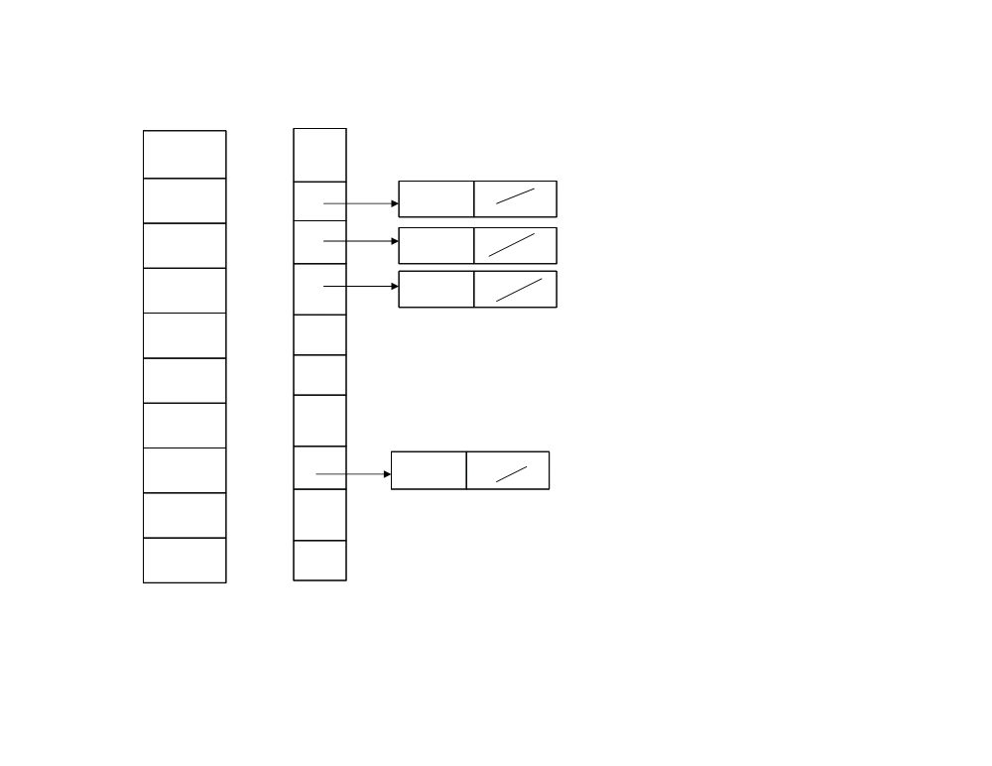
A
B
1 n = 10
2 for i = 4
1
.78
0
3 do insert A[4] into list B[10 * A [4]]
2
.17
1
.17
3
.39
2
.26
4
.26
3
.39
5
.72
4
6
.94
5
7
.21
6
8
.12
7
.78
9
.23
8
10
.68
9

Slide 27
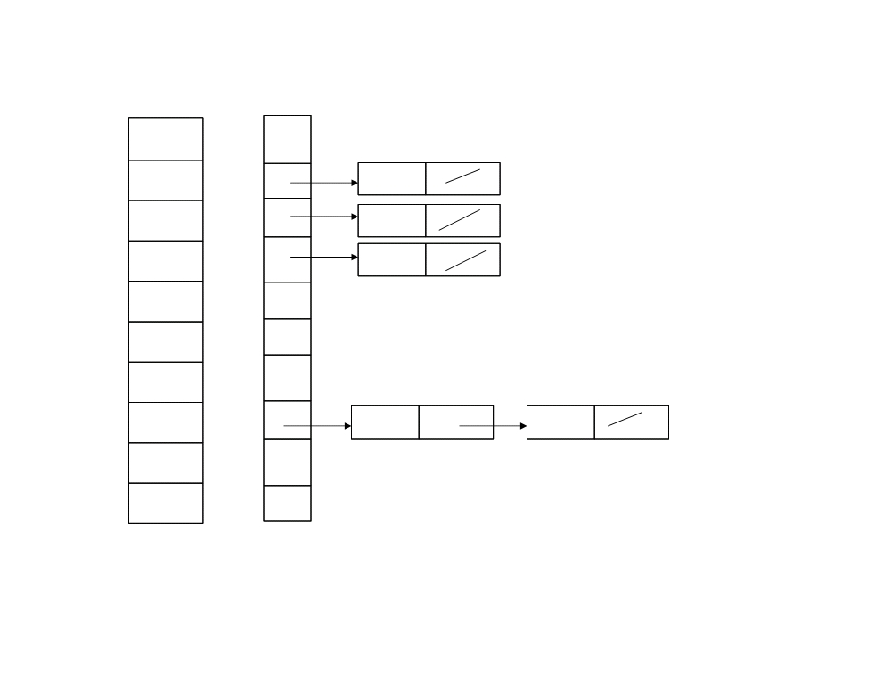
A
B
1 n = 10
2 for i = 5
1
.78
0
3 do insert A[5] into list B[10 * A [5]]
2
.17
1
.17
3
.39
2
.26
4
.26
3
.39
5
.72
4
6
.94
5
7
.21
6
8
.12
7
.78
.72
9
.23
8
10
.68
9

Slide 28
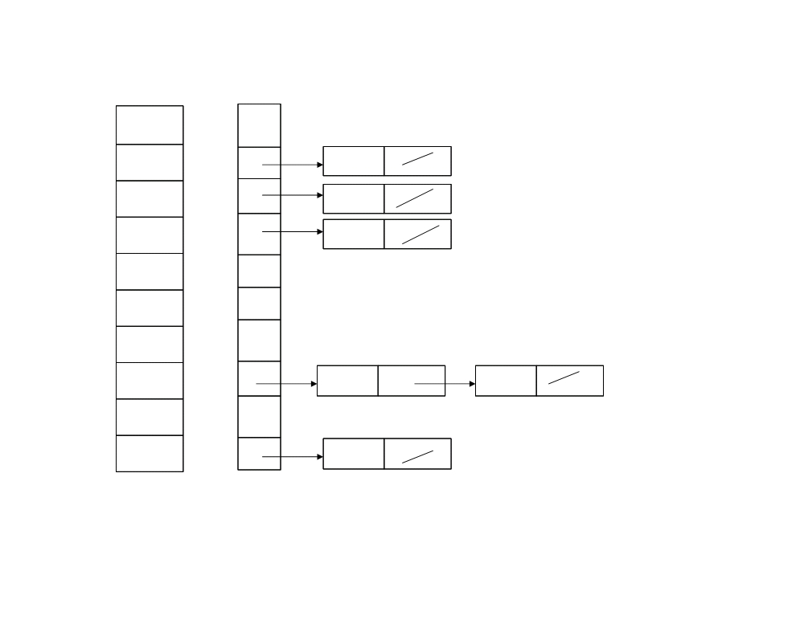
A
B
1 n = 10
2 for i = 6
1
.78
0
3 do insert A[6] into list B[10 * A [6]]
2
.17
1
.17
3
.39
2
.26
4
.26
3
.39
5
.72
4
6
.94
5
7
.21
6
8
.12
7
.78
.72
9
.23
8
10
.68
9
.94

Slide 29
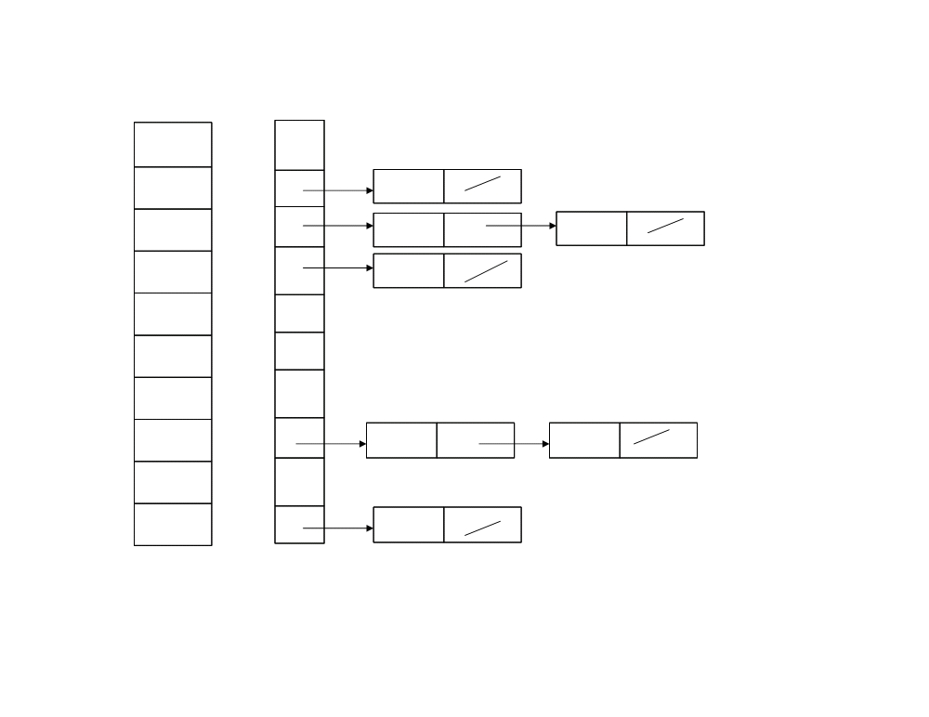
A
B
1 n = 10
2 for i = 7
1
.78
0
3 do insert A[7] into list B[10 * A [7]]
2
.17
1
.17
3
.39
2
.26
.21
4
.26
3
.39
5
.72
4
6
.94
5
7
.21
6
8
.12
7
.78
.72
9
.23
8
10
.68
9
.94

Slide 30
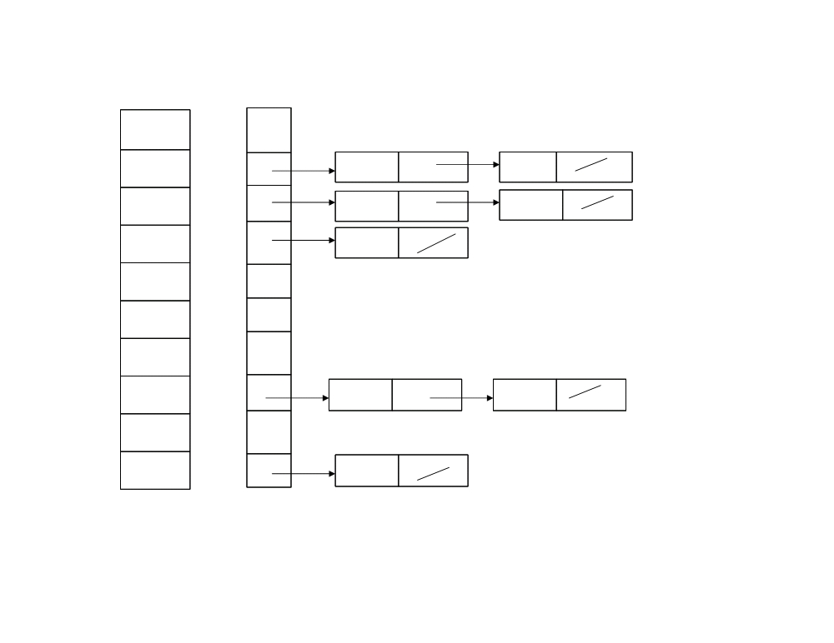
A
B
1 n = 10
2 for i = 8
1
.78
0
3 do insert A[8] into list B[10 * A [8]]
2
.17
1
.17
.12
3
.39
2
.26
.21
4
.26
3
.39
5
.72
4
6
.94
5
7
.21
6
8
.12
7
.78
.72
9
.23
8
10
.68
9
.94

Slide 31
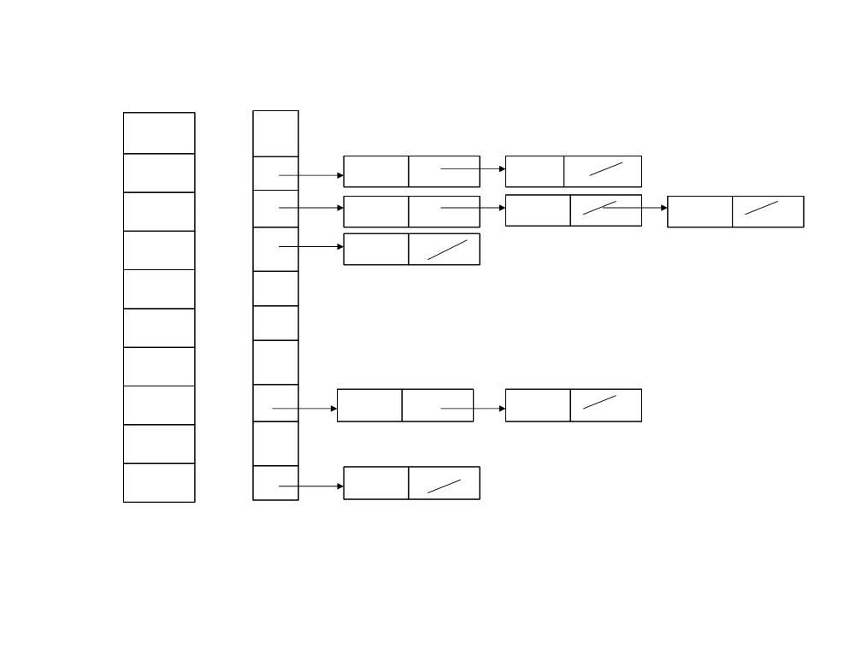
A
B
1 n = 10
2 for i = 9
1
.78
0
3 do insert A[9] into list B[10 * A [9]]
2
.17
1
.17
.12
3
.39
2
.26
.21 .23
4
.26
3
.39
5
.72
4
6
.94
5
7
.21
6
8
.12
7
.78
.72
9
.23
8
10
.68
9
.94

Slide 32
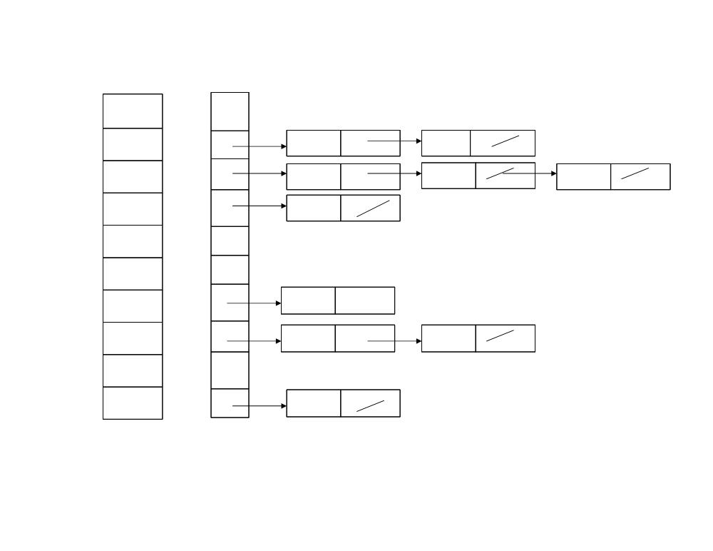
A
B
1 n = 10
2 for i = 10
1
.78
0
3 do insert A[10] into list B[10 * A [10]]
2
.17
1
.17
.12
3
.39
2
.26
.21 .23
4
.26
3
.39
5
.72
4
6
.94
5
7
.21
6
.68
8
.12
7
.78
.72
9
.23
8
10
.68
9
.94

Slide 33
A
B
4 - i = 0
5 - do sort list B[0] with insertion sort
1
.78
0
2
.17
1
.17
.12
3
.39
2
.26
.21 .23
4
.26
3
.39
5
.72
4
6
.94
5
7
.21
6
.68
8
.12
7
.78
.72
9
.23
8
10
.68
9
.94

Slide 34
A
B
4 - i = 1
5 - do sort list B[1] with insertion sort
1
.78
0
2
.17
1
.12
.17
3
.39
2
.26
.21 .23
4
.26
3
.39
5
.72
4
6
.94
5
7
.21
6
.68
8
.12
7
.78
.72
9
.23
8
10
.68
9
.94

Slide 35
A
B
4 - i = 2
5 - do sort list B[2] with insertion sort
1
.78
0
2
.17
1
.12
.17
3
.39
2
.21
.23 .26
4
.26
3
.39
5
.72
4
6
.94
5
7
.21
6
.68
8
.12
7
.78
.72
9
.23
8
10
.68
9
.94

Slide 36
A
B
4 - i = 3
5 - do sort list B[3] with insertion sort
1
.78
0
2
.17
1
.12
.17
3
.39
2
.21
.23 .26
4
.26
3
.39
5
.72
4
6
.94
5
7
.21
6
.68
8
.12
7
.78
.72
9
.23
8
10
.68
9
.94

Slide 37
A
B
4 - i = 4
5 - do sort list B[4] with insertion sort
1
.78
0
2
.17
1
.12
.17
3
.39
2
.21
.23 .26
4
.26
3
.39
5
.72
4
6
.94
5
7
.21
6
.68
8
.12
7
.78
.72
9
.23
8
10
.68
9
.94

Slide 38
A
B
4 - i = 5
5 - do sort list B[5] with insertion sort
1
.78
0
2
.17
1
.12
.17
3
.39
2
.21
.23 .26
4
.26
3
.39
5
.72
4
6
.94
5
7
.21
6
.68
8
.12
7
.78
.72
9
.23
8
10
.68
9
.94

Slide 39
A
B
4 - i = 6
5 - do sort list B[6] with insertion sort
1
.78
0
2
.17
1
.12
.17
3
.39
2
.21
.23 .26
4
.26
3
.39
5
.72
4
6
.94
5
7
.21
6
.68
8
.12
7
.78
.72
9
.23
8
10
.68
9
.94

Slide 40
A
B
4 - i = 7
5 - do sort list B[7] with insertion sort
1
.78
0
2
.17
1
.12
.17
3
.39
2
.21
.23 .26
4
.26
3
.39
5
.72
4
6
.94
5
7
.21
6
.68
8
.12
7
.72
.78
9
.23
8
10
.68
9
.94

Slide 41
A
B
4 - i = 8
5 - do sort list B[8] with insertion sort
1
.78
0
2
.17
1
.12
.17
3
.39
2
.21
.23 .26
4
.26
3
.39
5
.72
4
6
.94
5
7
.21
6
.68
8
.12
7
.72
.78
9
.23
8
10
.68
9
.94

Slide 42
A
B
4 - i = 9
5 - do sort list B[9] with insertion sort
1
.78
0
2
.17
1
.12
.17
3
.39
2
.21
.23 .26
4
.26
3
.39
5
.72
4
6
.94
5
7
.21
6
.68
8
.12
7
.72
.78
9
.23
8
10
.68
9
.94

Slide 43

Bucket-Sort (A)
1 n = length [A]
2
for i = 1 to n
3
do insert A [i] into list B [n * A [i]]
4
for i = 0 to n - 1
5
do sort list B [i] with insertion sort
6 concatenate the lists B[0], B[1] ... B[n-1] together in order

Slide 44
Analysis of Bucket Sort
All lines except line 5 takes O(n) time in worst case
n_{i} be the random variable denoting number of elements in the bucket B[i]
Expected time to sort the elements in Bucket B[i] in worst case is E(O(n_{i})²)
For the average case, we take the expectation over the input into account that each bucket will be linear to number of elements to be sorted in the array.
Even if the input is not drawn from a uniform distribution, bucket sort may still run in linear time. As long as the input has the property that the sum of the squares of the bucket sizes is linear in the total number of elements bucket sort will run in linear time.

Slide 45
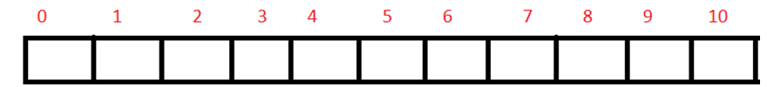
Example
Let us sort the elements by using bucket sort. Elements which need to be sort are 56, 12, 84, 28, 0,-13, 47, 94, 31, 12.

Slide 46
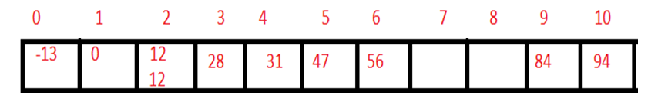
Now consider the range such that:
-20 to -1, 0 to 10 10 to 20, 20 to 30, 30 to 40, 40 to 50, 50 to 60, 60 to 70, 70 to 80, 80 to 90, 90 to 100.
For values 56, 12, 84, 28, 0,-13, 47, 94, 31, 12.

Slide 47
Task to submit before coming class
Application areas of both buckets and radix sort
Pros and cons of bucket and radix sort algorithm

Slide 48
Summary
Bucket sort performs at its worst, O(n^{​2}​​), when all elements at allocated to the same bucket.
What if we want to preserve the linear time for the best, and nlgn for the worst? What changes we need to done? This depends on the individual implementation though and can be mitigated. For example, a bucket sort algorithm could be made to work with large bucket sizes by using insertion sort on small buckets, and merge sort or quicksort on larger buckets.
Radix sorting is fantastic at sorting huge volumes of data. When the number of records, N, gets big enough, and there are plenty of values to sort, it's great.
Radix sort is suitable when number of digits in keys are same
Radix sort is not suitable when many keys are duplicate.

Slide 49
Heap Sort

Slide 50
Binary Tree
Binary tree : A tree in which every node other than the leaves has two children.
Complete Binary tree: A complete binary tree is a binary tree in which every level, except possibly the last, is completely filled.

Slide 51
Height of node: The height of a node is the number of edges on the longest path from the node to a leaf.
Height of tree: It is equal to the height of root node
Depth of node: The depth of a node is the number of edges in the path from root to that node
The height of a tree is equal to the max depth of a tree.

Slide 52
Binary Heap
A heap is a complete binary tree which satisfy heap ordering property (max heap or min heap)
Can be implemented efficiently in an array.
It can be used for heap sort and the efficient representation of certain dynamic priority lists, such the list of tasks to be scheduled by an operating system.

Slide 53
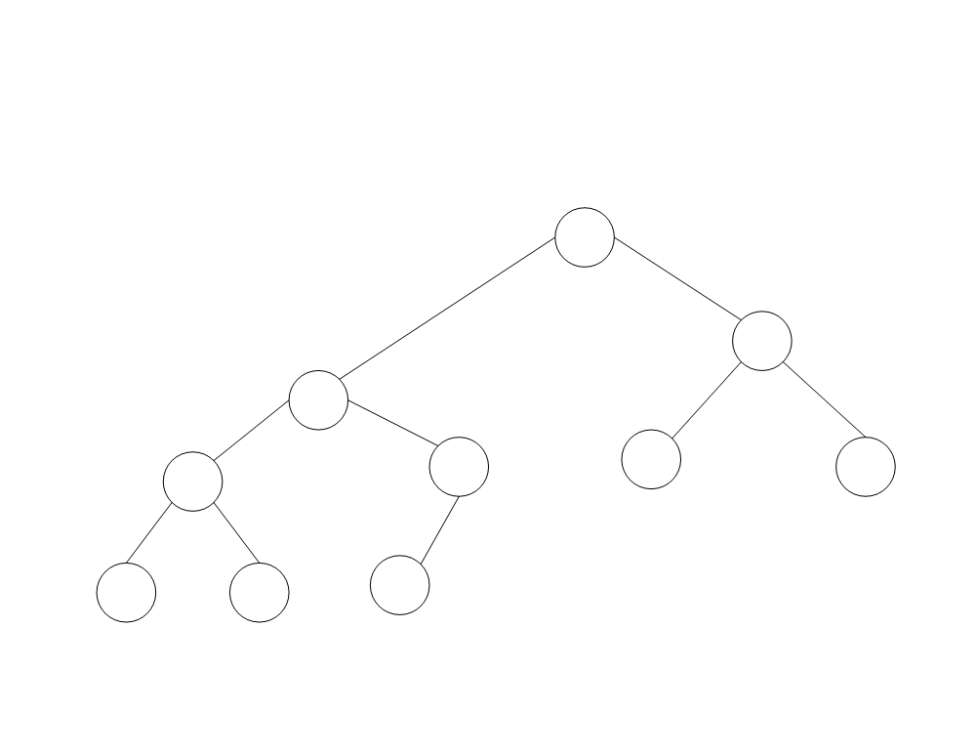
Heap : A complete binary tree
T[1]
T[3]
T[2]
T[4]
T[5]
T[6] T[7]
A complete binary tree containing 10 nodes.
Five internal nodes occupy level3 (the root), level 2, and the left side of level 1.
Five leaves fill the right side of level 1 and then continue at the left of level 0.
T[8] T[9]
T[10]

Slide 54
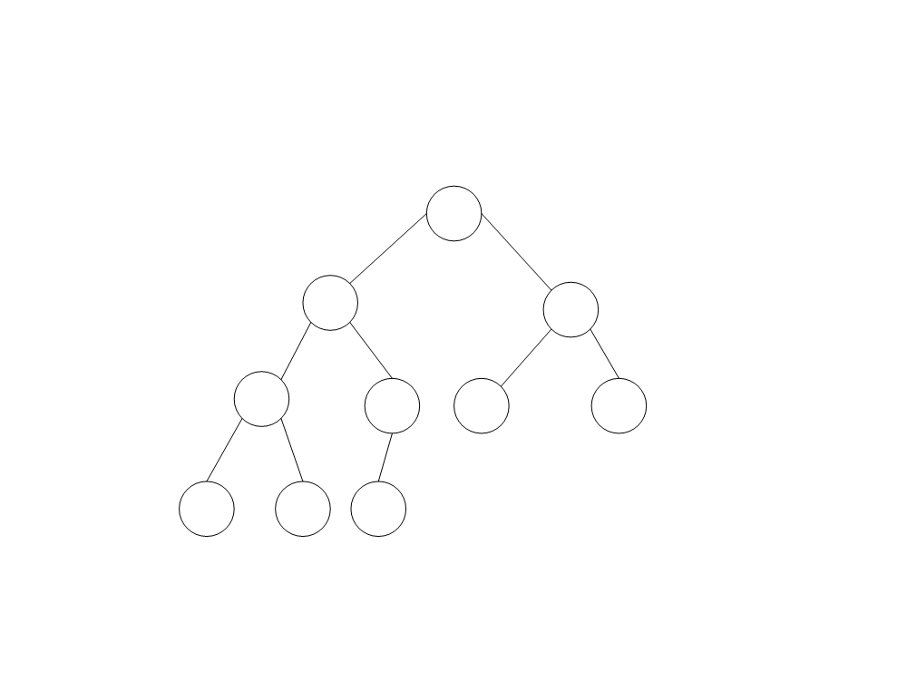
A heap
Now we have marked each node with its value
10
7
9
4
7
5
2
2
1
6
Figure shows an example of a heap with 10 nodes.

Slide 55
Heap
This same heap can be represented by the following array.
The crucial characteristic of this data structure is that the heap property can be restored efficiently if the value of a node is modified.
If the value of a node increases to the extent that it becomes greater than the value of its parent, it should be sufficient to exchange these two values, and then to continue the same process upwards in the tree if necessary until the heap property is restored.

Slide 56
Heap
The modified value is moved up to its new position in the heap
This operation is often called sifting up

Slide 57
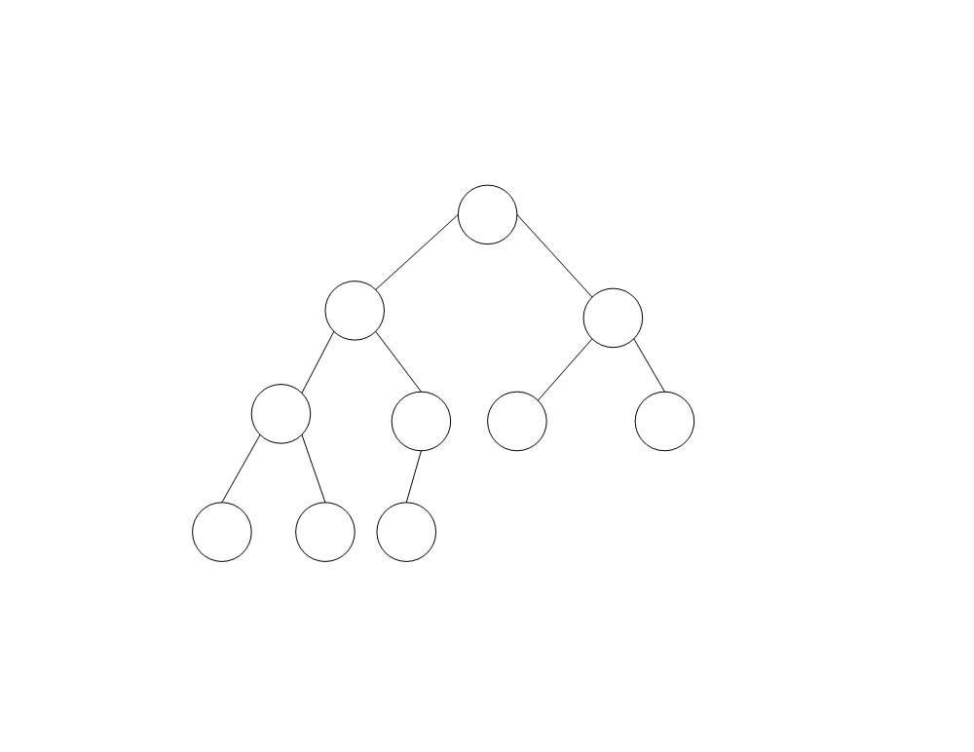
Replace 1 with 8:
The heap, after moving 8 to its place
10
8
9
7
7
5
2
2
4
6
If the value “1” in Figure is modified so that it becomes “8”, we can restore the heap property by exchanging the 8 with its parent “4” and then exchanging it again with its new parent “7”.

Slide 58
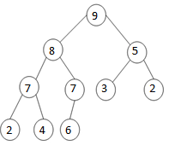
Heap
If on the contrary the value of a node is decreased so that it becomes less than the value of at least one of its children, it suffices to exchange the modified value with the larger of the values in the children, and then to continue this process downwards in the tree if necessary until the heap property is restored.
The heap, after sifting 3 (originally 10) down to its place
The modified value has been sifted down
to its new position.

Slide 59
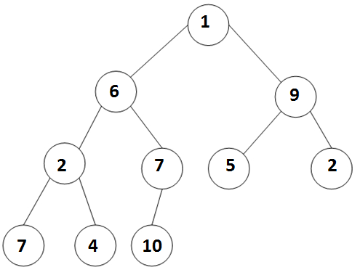
Making Heaps
There exists a clever algorithm for making a heap. Suppose, for example, that our starting point is the following array represented by the tree in Figure.
1 | 6 | 9 | 2 | 7 | 5 | 2 | 7 | 4 | 10
The starting situation

Slide 60
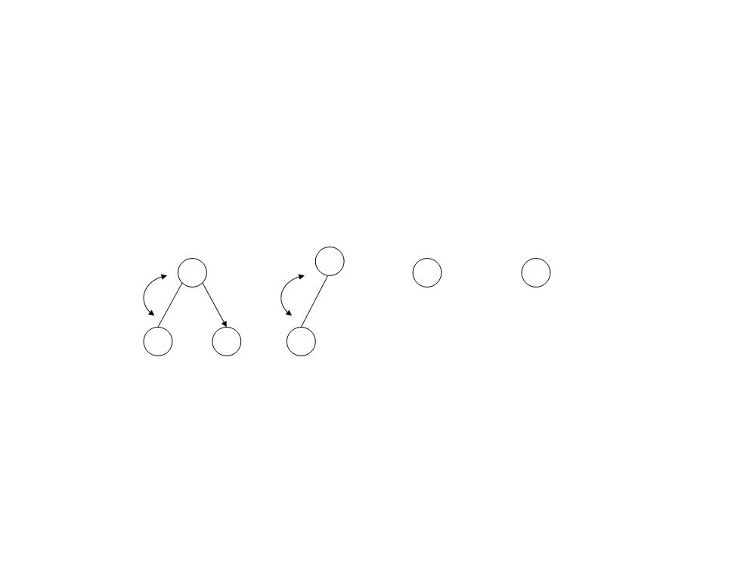
Heaps
We first make each of the subtrees whose roots are at level 1 into a heap, this is done by sifting down these nodes, as illustrated in Figure.
7
10
5 2
2 4 7
The level 1 subtrees are made into heaps

Slide 61
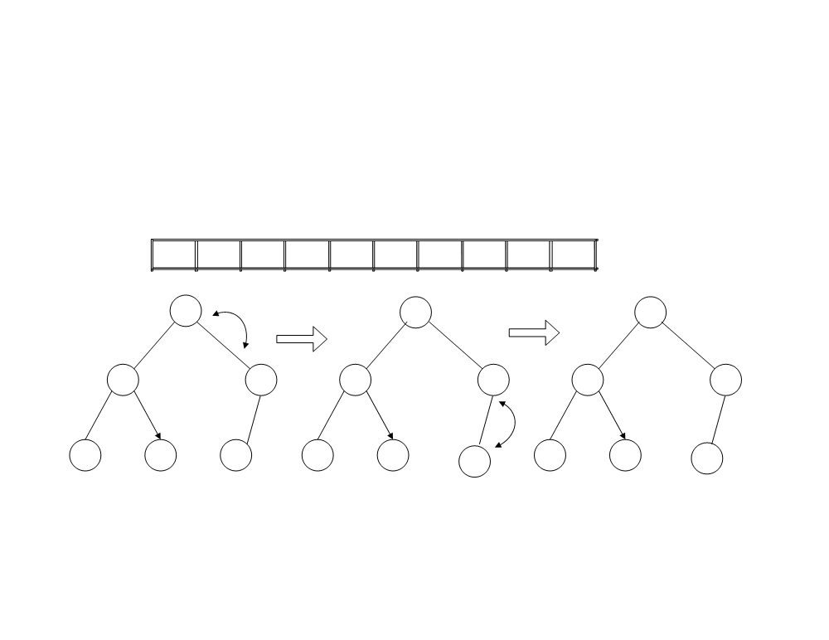
Heaps
This figure shows the process for the left subtree. The other subtree at level 2 is already a heap. This results in an essentially complete binary tree corresponding to the array.
1
10
9
7
7
5
2
2
4
6
6
10
10
7
10
7
6
7
7
2
4
7
2
4
7
2
4
6
One level 2 subtree is made into a heap (the other already is a heap)

Slide 62
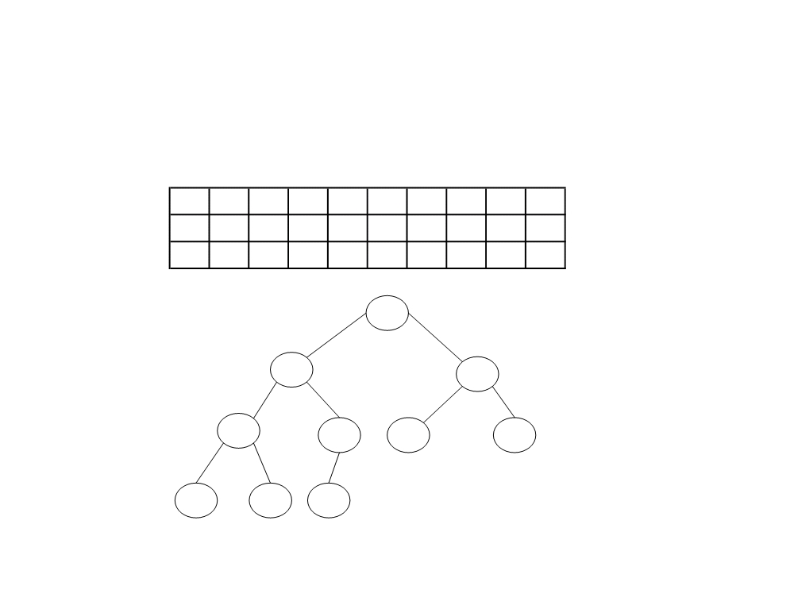
It only remains to sift down its root to obtain the desired heap. This process thus goes as follows:
10
1
9
7
7
5
2
2
4
6
10
7
9
1
7
5
2
2
4
6
10
7
9
4
7
5
2
2
1
6
10
7
9
4
7
5
2
2
1
6

Slide 63
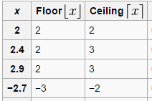
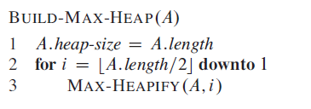
Build Heap

Slide 64
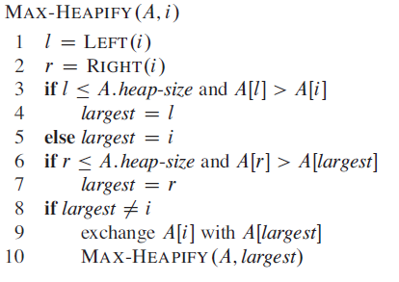
Max Heapify
// l = 2i
// r = 2i+1

Slide 65
Task
A=(16, 4, 10, 14, 7, 9, 3, 2, 8, 1)

Slide 66
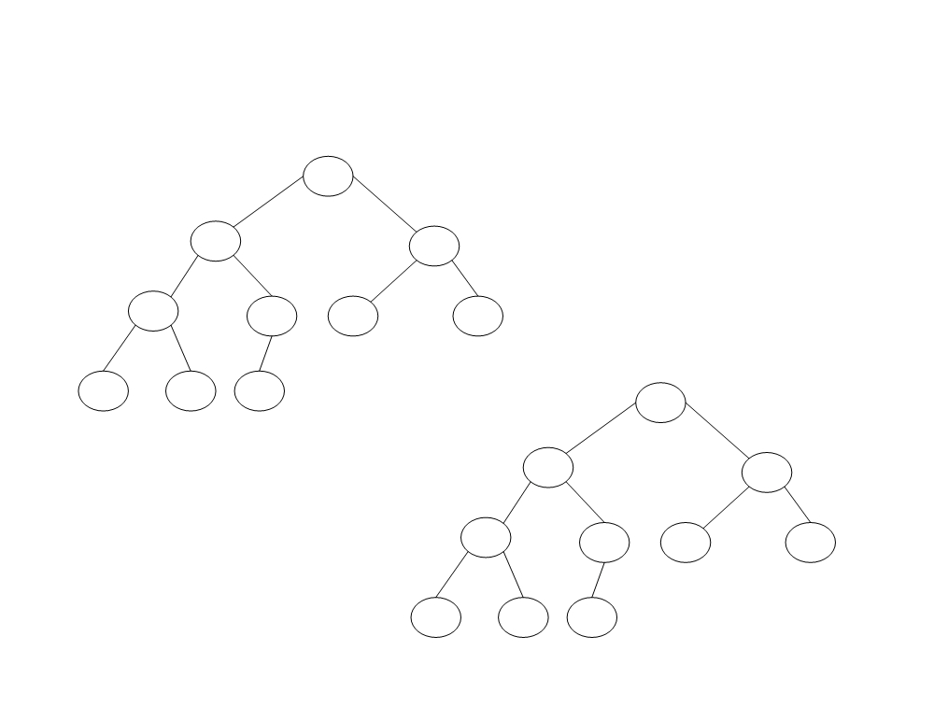
Build Heap
Construct the heap using the array A=(16, 4, 10, 14, 7, 9, 3, 2, 8, 1)
16
4 10
The initial configuration
14 7 9 3
2 8 1
16
14 10
8
7 9 3
Maintaining heap property
2
4 1

Slide 67

Worst case analysis of heap sort
Build heap (A) :
Time taken by max-heapify for nodes at lowest height is 0
Time taken by max-heapify for one node at height 1 is O(1)
How many nodes at height h of complete binary tree? ( n / 2^{h+1} )
Time taken by max-heapify for all node at h level is

Slide 68
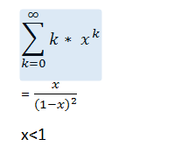





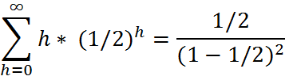

=

Slide 69
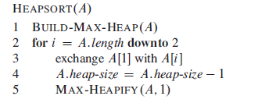
Heap sort

Slide 70
Heap sort
Ascending order
Build Max heap tree
In a max heap, the keys of parent nodes are always greater than or equal to those of the children and the highest key is in the root node.
Descending order
Build Min heap tree
In a min heap, the keys of parent nodes are less than or equal to those of the children and the lowest key is in the root node.

Slide 71
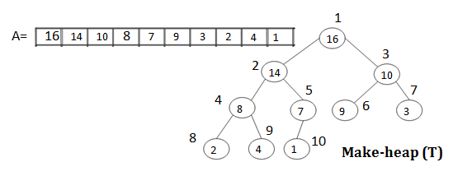
How to sort heap

Slide 72
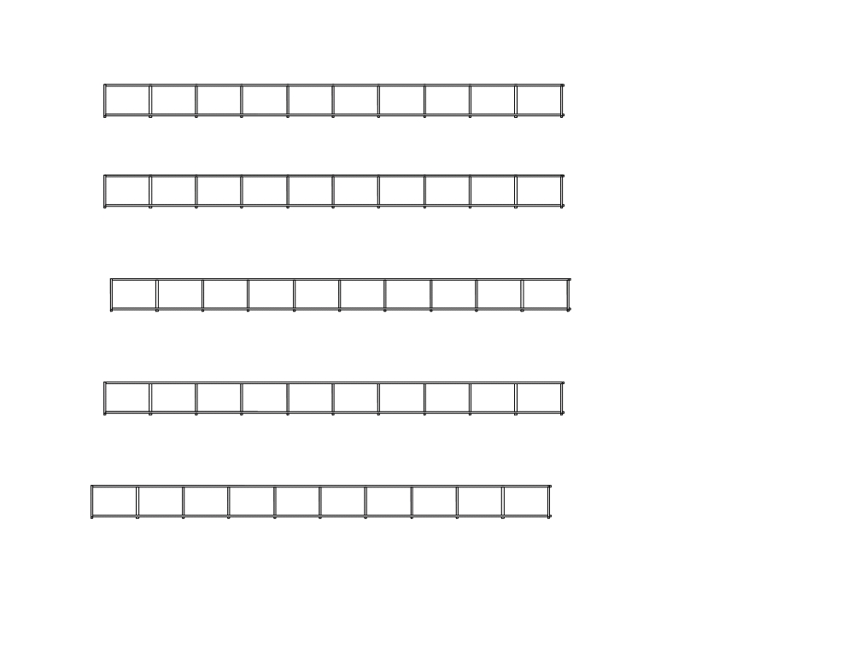
i = 10, exchange T[1] & T[10] and Max-heapify (T[1..9],1)
14
8
10
4
7
9
3
2
1
16
1
2
3
4
5
6
7
8
9
10
i = 9, exchange T[1] & T[9] and Max-heapify (T[1..8],1)
10
8
9
4
7
1
3
2
14
16
1
2
3
4
5
6
7
8
9
10
i = 8, exchange T[1] & T[8] and Max-heapify (T[1..7],1)
9
8
3
4
7
1
2
10
14
16
1
2
3
4
5
6
7
8
9
10
i = 7, exchange T[1] & T[7] and Max-heapify(T[1..6],1)
8
7
3
4
2
1
9
10
14
16
1
2
3
4
5
6
7
8
9
10
i = 6, exchange T[1] & T[6] and Max-heapify (T[1..5],1)
7
4
3
1
2
8
9
10
14
16
1
2
3
4
5
6
7
8
9
10

Slide 73
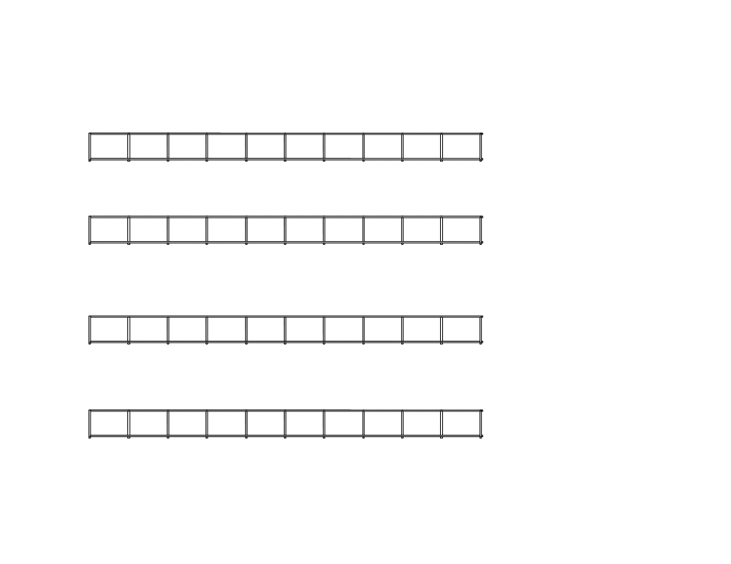
i = 5, exchange T[1] & T[5] and Max-heapify (T[1..4],1)
4
2
3
1
7
8
9
10
14
16
1
2
3
4
5
6
7
8
9
10
i = 4, exchange T[1] & T[4] and Max-heapify (T[1..3],1)
1
2
3
4
7
8
9
10
14
16
1
2
3
4
5
6
7
8
9
10
i = 3, exchange T[1] & T[3] and Max-heapify (T[1..2],1)
2
1
3
4
7
8
9
10
14
16
1
2
3
4
5
6
7
8
9
10
i = 2, exchange T[1] & T[2] and Max-heapify (T[1..1],1)
1
2
3
4
7
8
9
10
14
16
1 2 3 4
5 6 7 8 9 10
End of Sorting

Slide 74
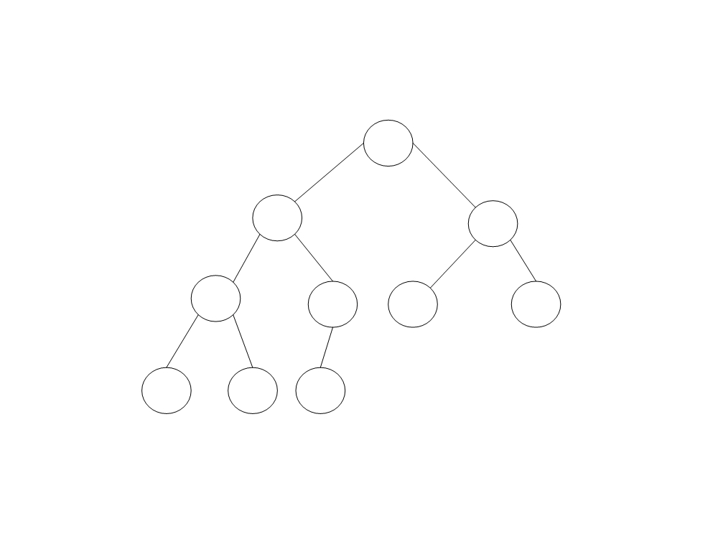
Sorted heap
1
2 3
4
7 8 9
10 14
16

Slide 75
Class Task:
1 | 6 | 9 | 2 | 7 | 5 | 2 | 7 | 4 | 10
Maintain minimum heap tree
Sort heap in descending order

Slide 76
Analysis of heap sort
Max-heapify (A,i) :
n-1 calls to Max-heapify = O(n log n)
(every time root value is shifted down to the leaf)
O(n) + O(n log(n)) = O(n log(n))
all you care about is the dominant term.
n log(n) dominates n so that's the only term that you care about.
Both worst and average case : O(nlogn)

Slide 77
Heap sort (Analysis) extra
log 1 + log 2 + log 3 + · · · + log n
<=log n + log n + log n + · · · + log n
<=n log n
O(n log n)

Slide 78
Task1
Sort the array in descending order using heap sort algorithm
24
21
23
22
36
29
30
34
28
27

Slide 79
Task2
Sort the array in descending order using heap sort algorithm
5
3
1
9
8
2
4
7

